Slide 1
Informatica PowerCenter
Lesson 3-Workflow Manager

Slide 2
Lesson Objectives
In this module you will learn about:
  Workflow Manager components
  Workflow Monitor
  Database connections
  Tasks
  Session Task
  Debugger

Slide 3

3.1: Workflow Manager components
Workflow
It is a set of instructions for the Integration service to perform the data transformation load
The Integration service retrieves mapping, Workflow, and session metadata from the repository to:
  Extract data from the source
  Transform it
  Load data into the target
It combines the logic of Session Tasks, other types of Tasks and Worklets
Figure 3.1
Notes:
Once a mapping is created in the Mapping Designer, the source to target dataflow specification is ready.
A Workflow is a set of instructions for the Integration Service to perform the data transformation and loading. When a Workflow starts, the Informatica Integration Service retrieves mapping, Workflow, and session metadata from the repository to extract data from the source, transform it, and load it into the target. It also runs the Tasks in the Workflow. The Integration Serviceuses Load Manager and Data Transformation Manager (DTM) processes to run the Workflow.
A Workflow combines the logic of Session Tasks, other types of Tasks and Worklets. A Session is a type of Task related to the movement of data through the Server. Tasks are the building blocks of a Workflow.

Slide 4
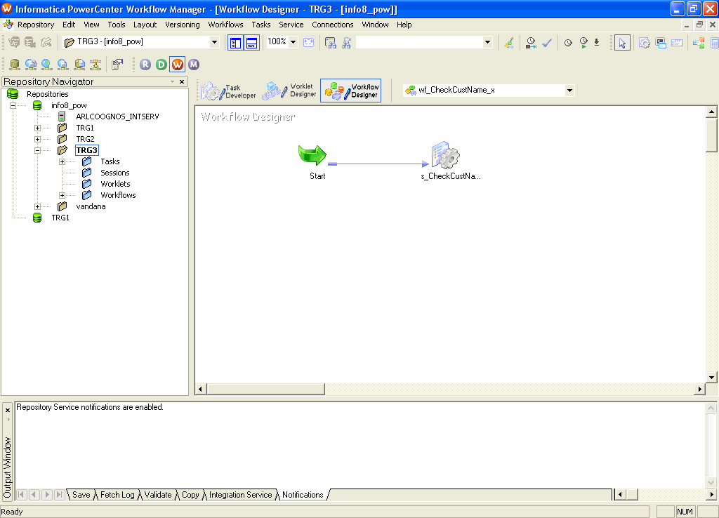
3.1: Workflow Manager components
Simple Workflow
Start Task
Link
Session Task
Figure 3.2
Notes:
The simplest Workflow is composed of:
Start Task
A Link
A Session Task (and any other Task as required for execution)
The first step to develop a Workflow is to create a new Workflow in the Workflow Designer. A Workflow must contain a Start Task. The Start Task represents the beginning of a Workflow.
When a Workflow is created, the Workflow Designer creates a Start Task and adds it to the Workflow. The Start Task cannot be deleted. The next step is to add Tasks to the Workflow. The Workflow Manager includes Tasks such as the Session Task, the Command Task, and the Email Task to design the Workflow.
Finally, the Workflow Tasks are connected with links to specify the order of execution in the Workflow.

Slide 5
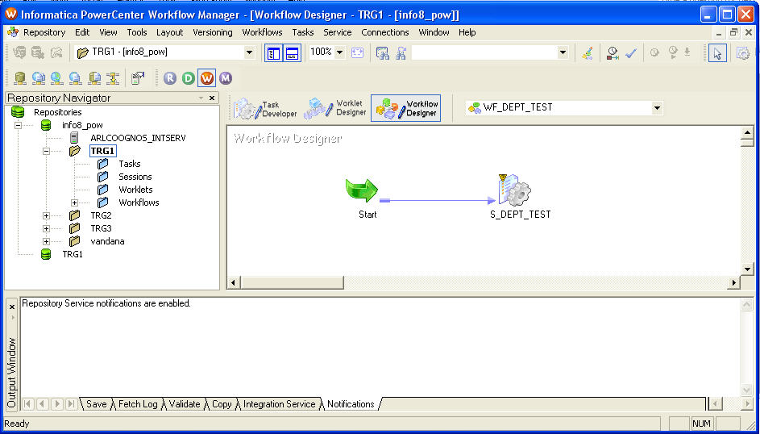
3.1: Workflow Manager components
Status Bar
Navigator
Window
Main Window
Output Window
Figure 3.3
Notes:
The Workflow Manager tool is used to define the workflow to execute mappings built in the Designer. After a Workflow is created, it is run in the Workflow Manager and monitored in the Workflow Monitor.
The Workflow Manager provides several windows:
The Navigator Window - Allows to view servers and all folders within a repository and the contents of those folders
The Main Window – Allows to view all the sessions that have been created and linked to make a complete Workflow
The Output Window - Contains messages from the server, such as success or failure to schedule or start sessions. The Output window contains the following tabs:
Save - Displays messages when a Workflow, a Worklet, or a Task is used. The Save tab displays a validation summary when a Workflow or a Worklet is saved
Fetch Log - Displays messages when the Workflow Manager fetches objects from the repository
Validate - Displays messages when a Workflow, a Worklet, or a Task is validated
Copy - Displays messages when repository objects are copied
Server - Displays messages from the Integration Service
Notifications - Displays messages from the Repository Service

Slide 6

3.1: Workflow Manager components
Development Tools
Task Developer
  To develop various Tasks like Session, Command etc in a Workflow
Worklet Designer
  To develop reusable Workflows
Workflow Designer
  To develop Workflows
Figure 3.4
Notes:
The Workflow Manager has three development tools:
Task Developer
Used to construct Session, Shell Command and Email Tasks
Tasks created in Task Developer are reusable in Worklets or Workflows
Worklet Designer
Used to construct an object which represents a set of Tasks
Worklets are reusable in multiple Workflows
Workflow Designer
“Maps” the execution order of Sessions, Tasks and Worklets for the Integration Service

Slide 7
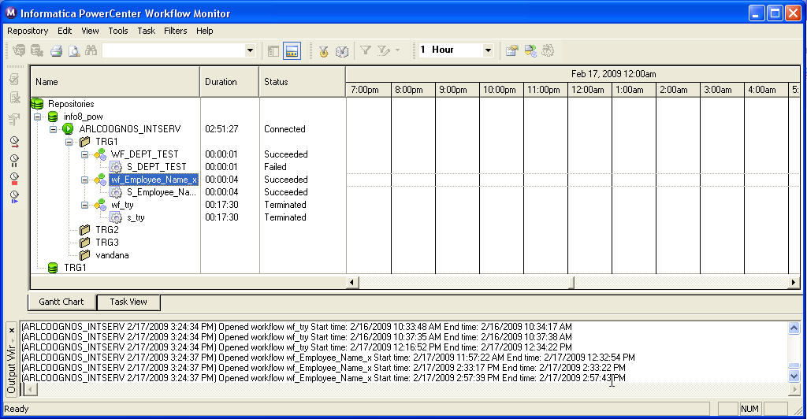
3.2: Workflow Monitor
Introduction
Is a tool used to monitor Workflows and Tasks
Displays the details of Workflow runs
Figure 3.5
Notes:
The Workflow Monitor is a tool used to monitor Workflows and Tasks. The details about a Workflow or a Task can be viewed in either Gantt Chart view or Task view. Workflows can be run, stopped, aborted, and resumed from the Workflow Monitor. The Workflow Monitor displays Workflows that have run at least once.

Slide 8
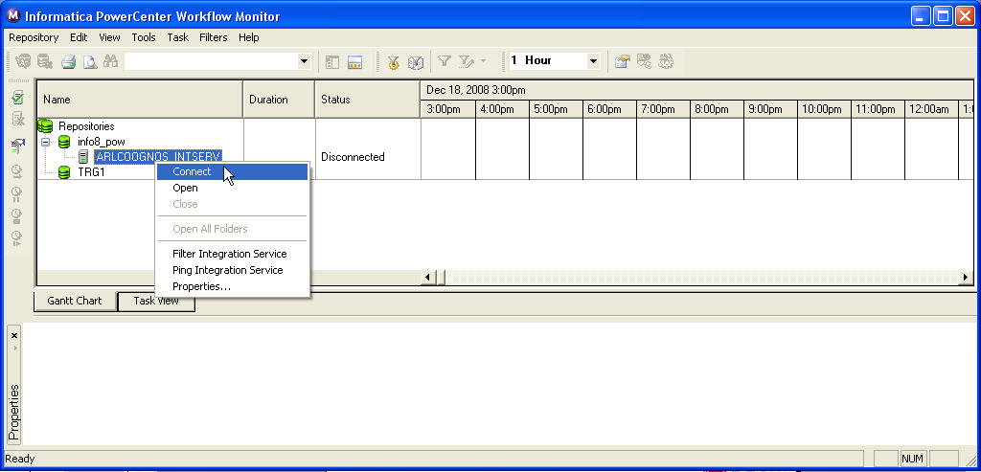
3.2: Workflow Monitor
Components
Time window
Navigator
window
Output window
Figure 3.6
Notes:
The Server can be monitored in two modes:
Online mode – In this mode, the Workflow Monitor continuously receives the information from the Integration Service and the Repository Service
Offline mode – Workflow Monitor displays historic information about past Workflow runs by fetching information from the Repository
The Workflow Monitor consists of the following windows:
Navigator window - Displays monitored repositories, servers, and repository objects
Output window - Displays messages from the Integration Service
Time window - Displays progress of Workflow runs

Slide 9
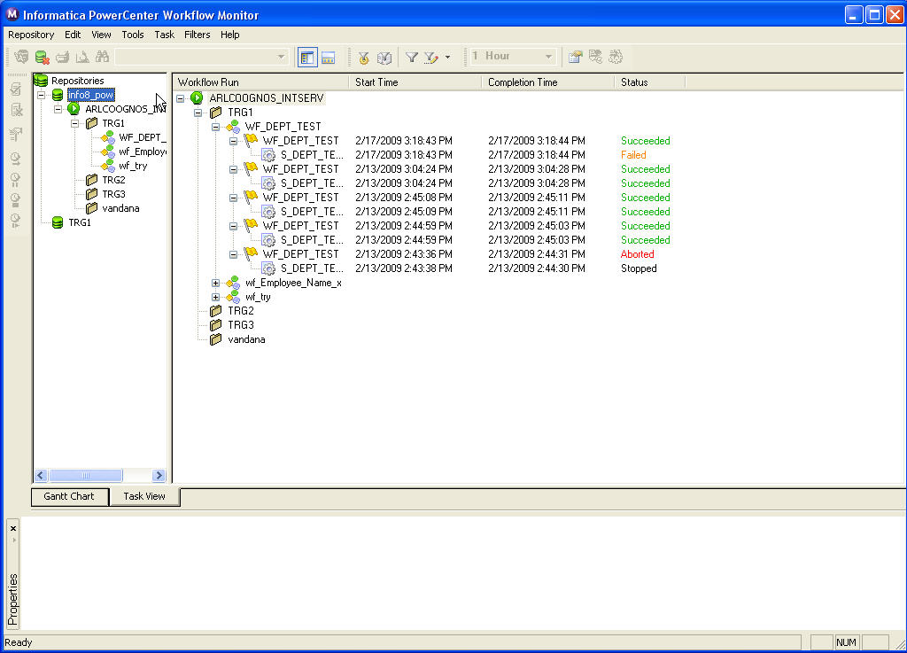
3.2: Workflow Monitor
Task View
Displays details about Workflow runs in a report format
The following details are displayed :
  Workflow run
  Task Name
  Worker Server
  Start time
  Completion time
  Status
  Run Type
  Task type
  User information
Figure 3.7
Notes:
The Task view displays details about Workflow runs in a report format. It displays the following details:
Task name - The name of the task will be displayed under the workflow name
Folder name - The name of the folder containing the Task
Status - The status of the Task or Workflow
Workflow name - The name of the Workflow
Worklet name - The name of the Worklet
Start time - The time that the Integration Service starts executing the Task or Workflow
Completion time - The time that the Integration service finishes executing the Task or Workflow
Status message - Message from the Integration Service regarding the status of the Task or Workflow
User name - Name of the user who owns the Workflow or Task
Run type - The method used to start the Workflow. Workflow can be manually started or scheduled to start
Task type - The type of the Task

Slide 10
3.2: Workflow Monitor
Gantt Chart View
Displays the details about Workflow runs in chronological format
The following details are displayed:
  Task name
  Duration
  Status
  Connection between
  Line 3.1.
    objects
Figure 3.8
Notes:
The Gantt Chart view displays details about Workflow runs in chronological format. It displays the following information:
Task name - Name of the Task in the Workflow
Duration - The length of time the Integration service spends executing the most recent Task or Workflow
Status - The status of the most recent Task or Workflow
Connection between objects - The Workflow Monitor shows links between objects in the Time window

Slide 11
3.3: Database Connections
Introduction
A database connection is configured in the Workflow Manager before the Server can access a source or target database in a session
When a session that reads from or writes to a relational database is created or modified, only configured source and target databases can be selected
Database connections are saved in the repository
Notes:
Before running any Workflow, the first thing that needs to be done is to configure a database connection. A database connection specifies the source and target database connection information. When a session that reads from or writes to a relational database is created or modified, only configured source and target databases can be selected.
For every source and target database used in the session, a separate database connection has to be configured.
To create a database connection, one of the following privileges is required:
Use Workflow Manager
Super User

Slide 12
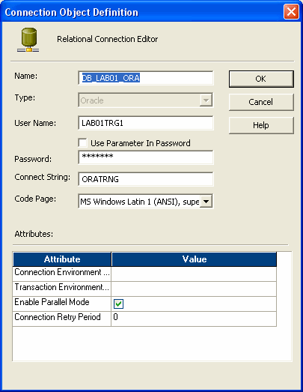
3.3: Database Connections
Information
To create a connection, the following information should be available:
  Database name
  Database type
  Database username
  Password
  Connect string
  Database code page
Figure 3.9
Notes:
To create a connection, the following information should be available:
Database name - Name for the connection
Database type - Type of the source or target database
Database username - Name of a user who has the appropriate database permissions to read from and write to the database
Password - Database password
Connect string - Connect string used to communicate with the repository
Database code page - Code page associated with the database

Slide 13
3.3: Database Connections
Demo
Notes:
Steps to create a Relational Database Connection:
In the Workflow Manager, connect to a repository.
Choose Connections | Relational menu option. A dialog box appears, listing all the registered source and target database connections.
Select the type of database connection to be created.
Click Add. The Connection Object Definition dialog box appears.
Enter the database connection name, database connection type, username, password, connect string and code page.
Click OK.

Slide 14
3.4: Tasks
Introduction
Tasks are used to build Workflows and Worklets
Tasks can be created in:
  Task Developer
  Workflow Designer
  Worklet Designer
Tasks created in the Task Developer are reusable
Tasks created in the Workflow Designer and Worklet Designer are non-reusable by default
Notes:
Tasks are building blocks of a Workflow. The Workflow Manager contains many types of Tasks to build Workflows and Worklets. Tasks created in the Task Developer are reusable and the ones created in the Workflow Designer and Worklet Designer are non-reusable.
The Workflow Manager validates Task attributes and links. If a Task is invalid, the Workflow becomes invalid. Workflows containing invalid sessions may still be valid.

Slide 15
3.4: Tasks
Workflow Tasks
Reusable Tasks
Task Name | Description
Session | Set of instructions to execute a mapping
Command | Specifies shell commands to run during the Workflow
Email | Sends email during the Workflow
Notes:
Reusable Tasks can be used in multiple Workflows in the same folder. The reusable Tasks can be seen in the Tasks node in the Navigator window.

Slide 16
3.4: Tasks
Workflow Tasks
Non-reusable Tasks
Task Name | Description
Event-Raise | Used to trigger a user-defined event
Event-Wait | Waits for a user-defined or a pre-defined event to occur
Timer | Waits for a specified period of time to execute the next Task
Control | Stops or aborts the Workflow
Decision | Specifies a condition to evaluate in the Workflow. Use the Decision Task to create branches in a Workflow
Notes:
Tasks created within the Workflow are non-reusable Tasks. The Non-reusable Tasks can be seen in the Sessions node in the Navigator window.

Slide 17

3.5: Session Task
Introduction
Created for each mapping to be run on the Integration Service
Integration Service uses the instructions configured in the session to move data from sources to targets
Figure 3.10
Notes:
A Session Task is the basic object created in the Workflow Manager that assembles the information contained in a mapping together with database connection and other information. It is the vehicle for commanding the Integration Service to extract, transform, and load data and report session status and performance characteristics. A Workflow groups two or more sessions to run sequentially or concurrently or as specified in the Workflow.
A reusable Session Task is created in the Task Developer. We can also create Session Tasks in the Workflow Designer as we develop the Workflow. Once the Session is created, the session properties can be edited at any time.

Slide 18

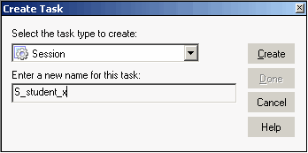
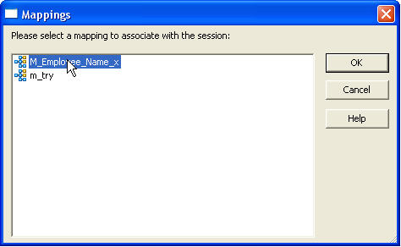
3.5: Session Task
Create Session Task
Create a Task
Select the type of Task and give a name to the Task
Select the mapping to be associated with the Task
Figure 3.11
Figure 3.12
Figure 3.13
Notes:
To create a new Session Task, the following information is required:
Mapping used for the Session Task
Session name, which must be unique among all sessions in a given folder
Source type
Update strategy for writing to targets
Target type
Note: Before creating a Session Task, the Workflow Manager has to be configured to communicate with databases and the Integration service. Appropriate permissions have to be assigned for any database, FTP, or external loader connections.

Slide 19
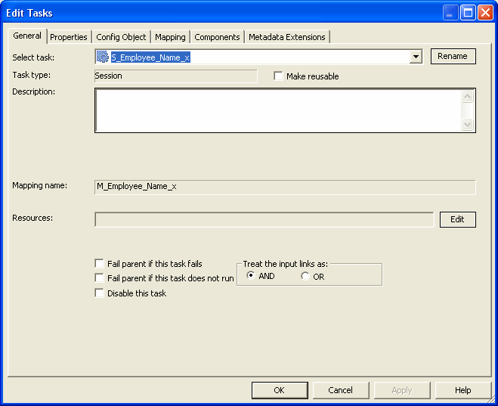
3.5: Session Task
Properties
The Session Task properties has the following tabs
  General
  Properties
  Config Object
  Mapping
  Components
Metadata Extension
Figure 3.14
Notes:
The Session Task properties has the following tabs:
General - Specifies session name, mapping name, and description for the Session Task
Properties - Specifies Session log information, test load settings, and performance configuration
Config Object - Specifies advanced settings, log options, and error handling configuration
Mapping – Specifies source, target information and Override transformation properties
Components - Configure pre- or post-session shell commands and emails
Metadata Extension - Associate additional non-business information with repository objects

Slide 20
3.6: Create a Workflow and Task
Demo
Notes:
To create a Workflow:
Open the Workflow Designer.
Choose Workflows | Create menu option.
Enter a name for the new Workflow.
Click OK.
To create a Task:
In the Workflow Designer, click the Session Task icon on the Tasks toolbar.
Choose Tasks | Create menu option.
Select Session task for the Task type. Enter a name for the Session Task.
Click Create. The Mappings dialog box appears.
Select the mapping to be used in the Session Task and click OK.
Click Done. The Session Task appears in the workspace.

Slide 21
3.7: Debugger
Information
The Debugger is used to debug a valid mapping to trace errors and gain more insight into the data
The mapping can be debugged
  Before a session is run
  After a session is run
The Debugger can run for the following session types:
  Existing non-reusable session
  Existing reusable
  Debug session instance
Notes:
You can debug a valid mapping to know about data and error conditions. To debug a mapping, the Debugger is configured and run from within the Mapping Designer.
When the Debugger is run, it pauses at breakpoints and allows viewing and editing of transformation output data.
The Debugger uses a session to run the mapping on the PowerCenter Server.
When the Debugger is configured, three different debugger session types can be selected. The Debugger runs a workflow for each session type. The Debugger session types are :
Existing non-reusable session for the mapping. The Debugger uses existing source, target, and session configuration properties. When the Debugger is run, the PowerCenter Server runs the non-reusable session and the existing workflow.
Existing reusable session for the mapping. The Debugger uses existing source, target, and session configuration properties. When the Debugger is run, the PowerCenter Server runs a debug instance of the reusable session and creates and runs a debug workflow for the session.

Slide 22
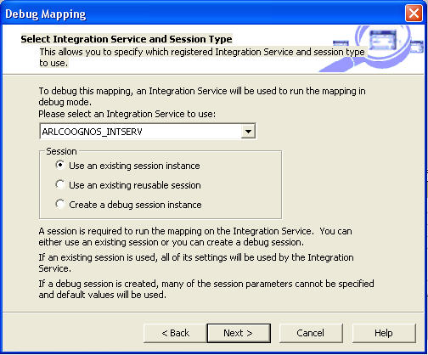
Debugger
Figure 3.15
contd.
Notes:
Debug session instance created for the mapping. Using the Debugger Wizard, the user can configure source, target, and session configuration properties. When the Debugger is run, the PowerCenter Server runs a debug instance of the debug workflow and creates and runs a debug workflow for the session.
Debug Process
Use the following process to debug a mapping:
Create breakpoints. Create breakpoints in a mapping if PowerCenter Server is to evaluate data and error conditions.
Configure the Debugger. Use the Debugger Wizard to configure the Debugger for the mapping. Select the session type the PowerCenter Server uses when it runs Debugger. When a debug session is created, a subset of session properties within the Debugger Wizard need to be configured, such as source and target location. You can also choose to load or discard target data.
Run the Debugger. Run the Debugger from within the Mapping Designer. When the Debugger is run, the Designer connects to the PowerCenter Server. The PowerCenter Server initializes the Debugger and runs the debugging session and workflow. The PowerCenter Server reads the breakpoints and pauses the Debugger when the breakpoints evaluate to true.

Slide 23
3.8:Debug a Mapping using the Debugger
Demo
Notes:
To use the Debugger
Select a valid mapping.
Select Mappings – Debugger – Edit Breakpoints to create breakpoints if any.
Select Mappings – Debugger – Start Debugger to invoke the Debugger.
Select the server, session type, session instance and target table options to configure the debugger.
Monitor the debugger. Observe transformation data in the instance window and target data in the target window.
Modify data if required.

Slide 24
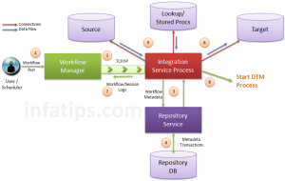
PowerCenter Integration Service Process
Integration Service mainly consists of three process
Integration Service Process
Load Balancer
Data Transformation Manager(DTM)
Integration Service Process:
  Integration Service process is responsible
  to carry out below tasks:
  Workflow Schedule Management
  Locking Workflow Before Execution
  Reading Parameter File
  Creating Workflow Logs
  Running any Tasks in Workflow (e.g., Email)
  Creating DTM processes to run Workflow Sessions
Notes:
Whenever Integration Service receives a request to execute a workflow, it spawns an Integration Service Process. In admin community it is typically called as pmserver process.
Note that Integration Service can start one or multiple Integration Processes to run and monitor Workflows.
Whenever a workflow is scheduled or changed, Workflow Manager interacts with Integration Service Process. This interaction happens over TCP/IP. Integration Service process locks the Workflow and then knocks the Repository Service to get metadata about Workflow. Repository Service intern connects to Repository Database – fetches desired information – and gives it back to Integration Service process.
Once Integration Service process receives metadata information back from Repository Service, it creates connections to Source and Target databases using ODBC or Native drivers. Integration Service process also creates connections to any lookup or stored procedure databases which are used by the Workflow. Once the data loading process is done, Integration Service process releases and closes all open database connections.
Integration Service process is also responsible to start DTM process that will actually execute Workflow Sessions. Integration Service process passes Parameter File and Session information to DTM process, that helps it to retrieve required metadata from the repository. Please refer to article Data Transformation Manager for details on DTM Process.

Slide 25
Load Balancer / Manager
While running a Workflow, the PowerCenter Server uses the Load Manager process and the Data Transformation Manager Process (DTM) to run the workflow and carry out workflow tasks. When the PowerCenter Server runs a workflow, the Load Manager performs the following tasks:
1. Locks the workflow and reads workflow properties.
2. Reads the parameter file and expands workflow variables.
3. Creates the work flow log file.
4. Runs workflow tasks.
5. Distributes sessions to worker servers.
6. Starts the DTM to run sessions.
7. Runs sessions from master servers.
8. Sends post-session email if the DTM terminates abnormally.

Slide 26
DTM Process
When the PowerCenter Server runs a session, the DTM performs the following tasks:
1. Fetches session and mapping metadata from the repository.
2. Creates and expands session variables.
3. Creates the session log file.
4. Validates session code pages if data code page validation is enabled. Checks query
conversions if data code page validation is disabled.
5. Verifies connection object permissions.
6. Runs pre-session shell commands.
7. Runs pre-session stored procedures and SQL.
8. Creates and runs mapping, reader, writer, and transformation threads to extract, transform, and load data.
9. Runs post-session stored procedures and SQL.
10. Runs post-session shell commands.
11. Sends post-session email.

Slide 27
Code Page And Data Movement Modes
The data movement mode depends on whether Informatica Server should process single byte or multi-byte character data. This mode selection can affect the enforcement of code page relationships and code page validation in the Informatica Client and Server.
a) Unicode – IS allows 2 bytes for each character and uses additional byte for each non-ascii character (such as Japanese characters)
b) ASCII – IS holds all data in a single byte.
The IS data movement mode can be changed in the Informatica Server configuration parameters. This comes into effect once you restart the Informatica Server.
Code Page is used to identify characters that might be in different languages.
Incorrect selection of Code Page can lead to Junk Data or rejection of data.
ASCII, UTF-8, UTF-16, UTF-32 are few examples for encoding/ Code pages available in Informatica.

Slide 28
Audit Trails Output Files
While Informatica Load Manager and DTM treads together executes the code , it also creates multiple files for audit trails. These files help us in analysis the code for performance enhancement and data quality
Informatica server log: Informatica server (on UNIX) creates a log for all status and error messages (default name: pm.server.log). It also creates an error log for error messages. These files will be created in Informatica home directory.
Session log file: Informatica server creates session log file for each session. It writes information about session into log files such as initialization process, creation of sql commands for reader and writer threads, errors encountered and load summary. The amount of detail in session log file depends on the tracing level that you set.
Session detail file: This file contains load statistics for each target in mapping. Session detail includes information such as table name, number of rows written or rejected. You can view this file by double clicking on the session in monitor window.

Slide 29
Audit Trails Output Files
Performance detail file: This file contains information known as session performance details which helps you where performance can be improved. To generate this file select the performance detail option in the session property sheet.
Reject file: This file contains the rows of data that the writer does not write to targets.
Control file: Informatica server creates control file and a target file when you run a session that uses the external loader. The control file contains the information about the target flat file such as data format and loading instructions for the external loader.
Post session email: Post session email allows you to automatically communicate information about a session run to designated recipients. You can create two different messages. One if the session completed successfully the other if the session fails.

Slide 30
Audit Trails Output Files
Indicator file: If u use the flat file as a target, you can configure the informatica server to create indicator file. For each target row, the indicator file contains a number to indicate whether the row was marked for insert,update,delete or reject.
Output file: If session writes to a target file, the informatica server creates the target file based on file properties entered in the session property sheet.
Cache files: When the informatica server creates memory cache it also creates cache files. For the following circumstances informatica server creates index and datacache files.
Aggregator transformation
Joiner transformation
Rank transformation
Lookup transformation

Slide 31
Summary
After completing this module you now know:
  The Workflow Manager components
  What is a Task
  How to create Workflow
  How to create a Task
  Use the Debugger

Slide 32
Review Question
Question 1: The ______ is the connection between the server and the repository
Question 2: Workflow monitor displays details about Workflow runs in two views: _________and ______
Question 3: ______ are reusable in multiple Workflows

Slide 33
Review Question
Question 4: Session Task is a reusable Task.
  True/False
Question 5: The Debugger can be used for an invalid mapping.
  True/False

